Slide 1

FFPM 241

Slide 2
FIARAHABANA APOSTOLIKA

Slide 3
FISAORANA SY FIDERANA AN' ANDRIAMANITRA

Slide 4
sdsad

Slide 5
FF 33

Slide 6

VAVAKA

Slide 7
FANKALAZANA NY TENIN' ANDRIAMANITRA

Slide 8
FOTOANA HO AN'NY ANKIZY SY NY TANORA

Slide 9
sdasd

Slide 10
ANTEMA 14

Slide 11
VAVAKA

Slide 12

VAKITENY
hihi hoho haha

Slide 13
FFPM 136

Slide 14
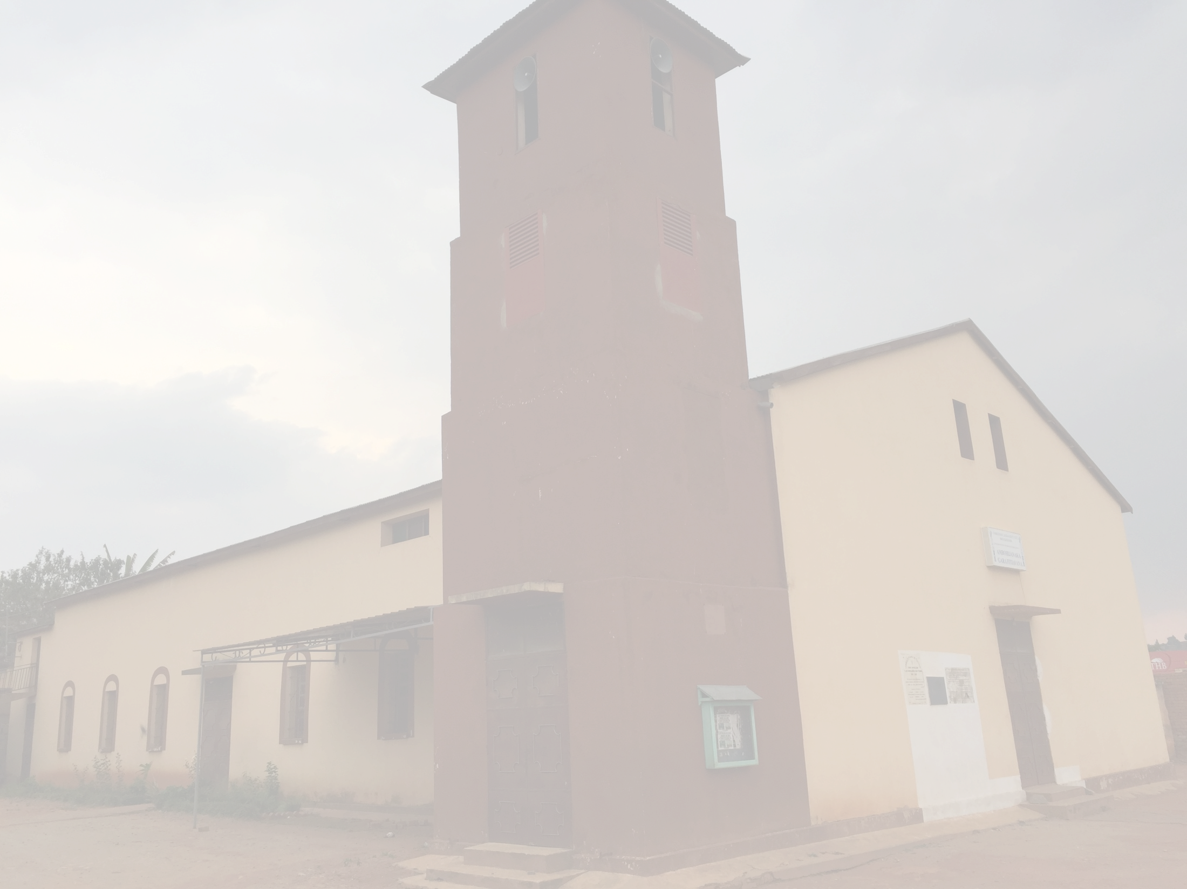
TORITENY

Slide 15

FEON-JAVAMANENO

Slide 16
VAVAKA SY RAINAY

Slide 17
FANEKEM-PINOANA VOALOHANY

Slide 18
FEON-JAVAMANENO

Slide 19
ASAN' ANDRIAMANITRA

Slide 20
Harona mamangy

Slide 21
RAHARAHAM-PIANGONANA

Slide 22
RAKITRA

Slide 23
FFPM 127

Slide 24
FANOLORANA NY RAKITRA

Slide 25
ASA VAVOLOMBELONA

Slide 27
FFPM 212

Slide 28
VAVAKA

Slide 29

TSODRANO

Slide 30
FFPM 353

Slide 31
TRINITE

Slide 32
FIRAVANA

